Slide 1
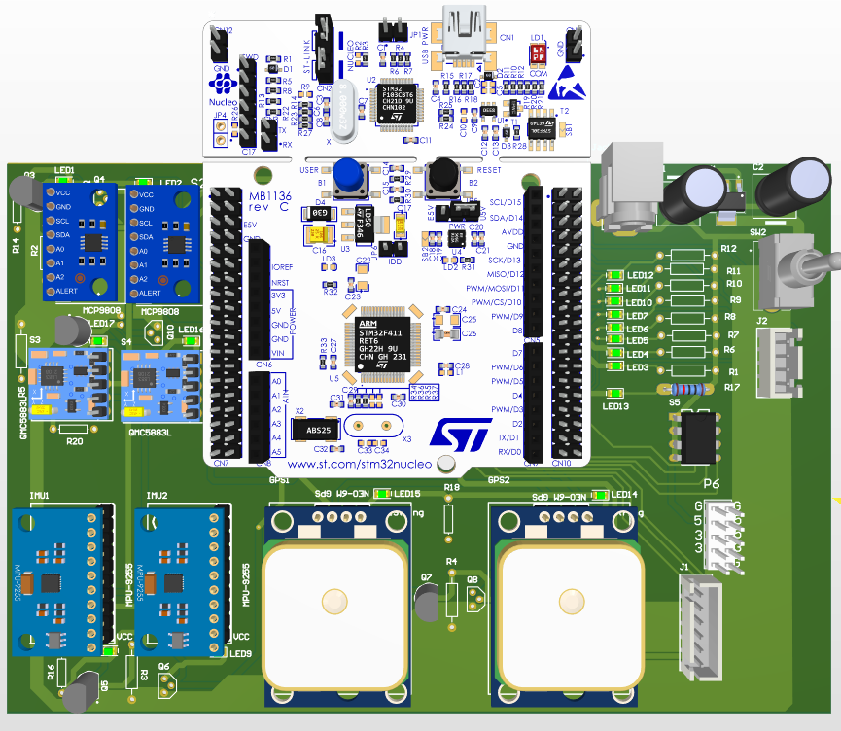
ADCS Sub-System

Slide 2

ADCS RESPONSIBILITIES
Altitude determination
Altitude Control
Microcontroller
Sensors
Actuators

Slide 3

ADCS Sensors
Magnetometer
Sun sensor
GPS
IMU

Slide 4
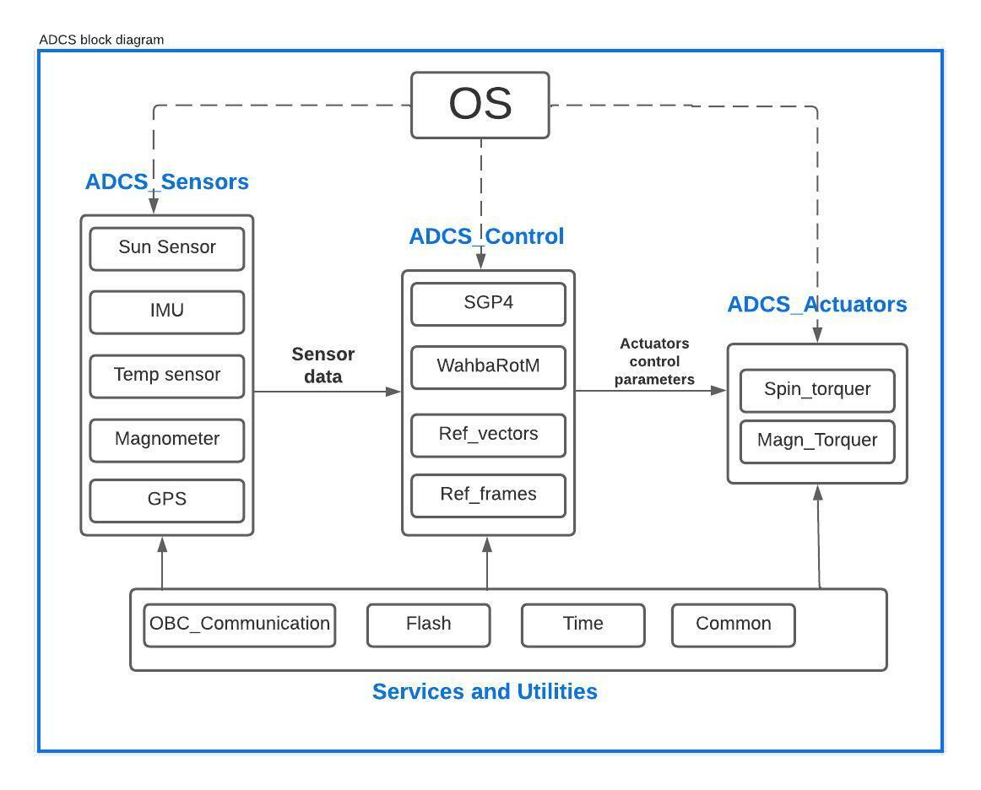
ADCS Static Design

Slide 5
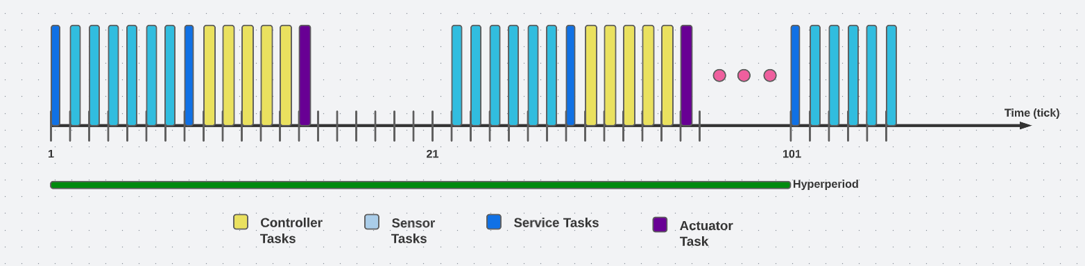
ADCS Dynamic Design

Slide 6
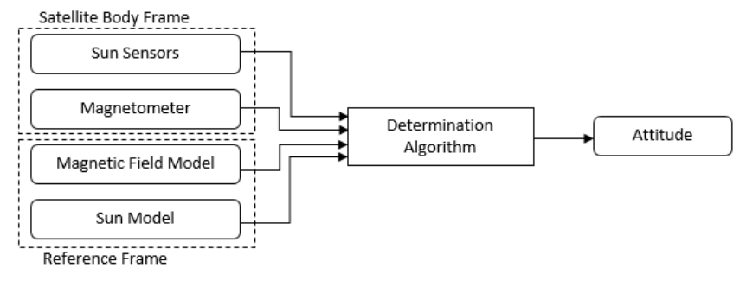
Altitude Determination

Slide 7
Further Work
Flight model
Mission subsystem
Improve hardware designs

